Slide 1
WI/VC survey
Findings of data exploration and clustering

Slide 2
Glossary
Terms used in analysis:
TOTAL_ANSWERS = YES_ANSWERS + NO_ANSWERS + NA_ANSWERS
IMP_SUCC = ( Total Answers / Impressions) * 100 %
Ssmaller values appearing the graphs have a are like eg. 440m which means 0.44
YES_SUCC = (YES_ANSWERS/TOTAL_ANSWERS)*100 %
NO_SUCC = (NO_ANSWERS/TOTAL_ANSWERS)*100 %
NA_SUCC = (NA_ANSWERS/TOTAL_ANSWERS)*100 %

Slide 3
Data Exploration
What are unique values of features of interest?
There are 14 different projects surveyed in 13 different countries. These projects are released between Feb’21 to Dec’21 and surveyed among male and female users rangeing from under 25 years to over 55 years of age.
How many projects are released per month?

Slide 4
Data Exploration WI Surveys
What are the total impressions for all projects across different campaign countries?
Highest and least impressions
Expenditure on marketing
Local production projects
Widely suveyed projects

Slide 5
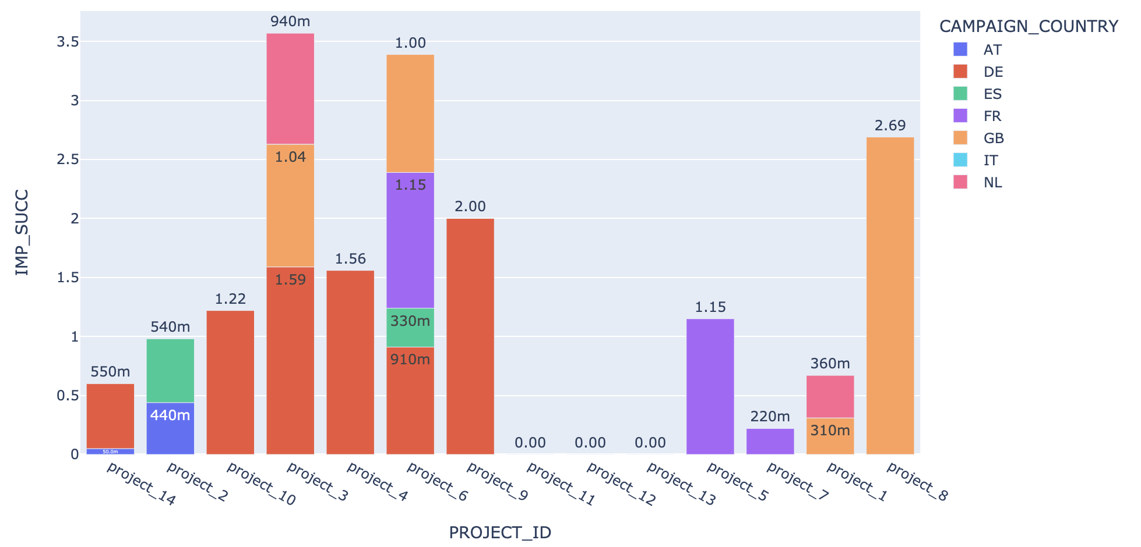
Data Exploration WI Surveys
What is the percentage of total reponses for different projects across all countries?
Highest and least total response percentages
Highest response percentage from a
single country
Project with no reponses
Most responded projects in
different countries
Note:
IMP_SUCC = (Total_responses/
Impressions)
Eg. 440m = 0.44%

Slide 6
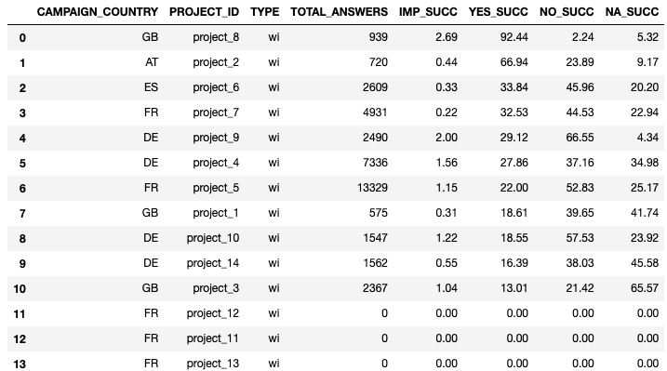
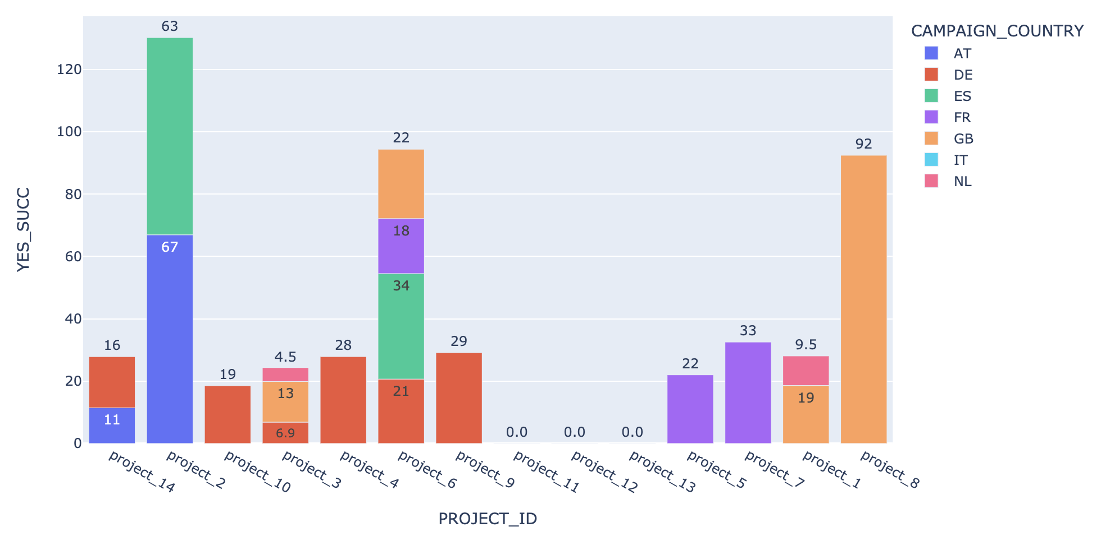
Data Exploration WI Surveys
What is the percentage of positive responses for different projects across all countries?
Highest and least positive response percentage
Highest positive repsonse percentage from single country
Relation between impressions response differnce and corresponding marketing campaigns

Slide 7
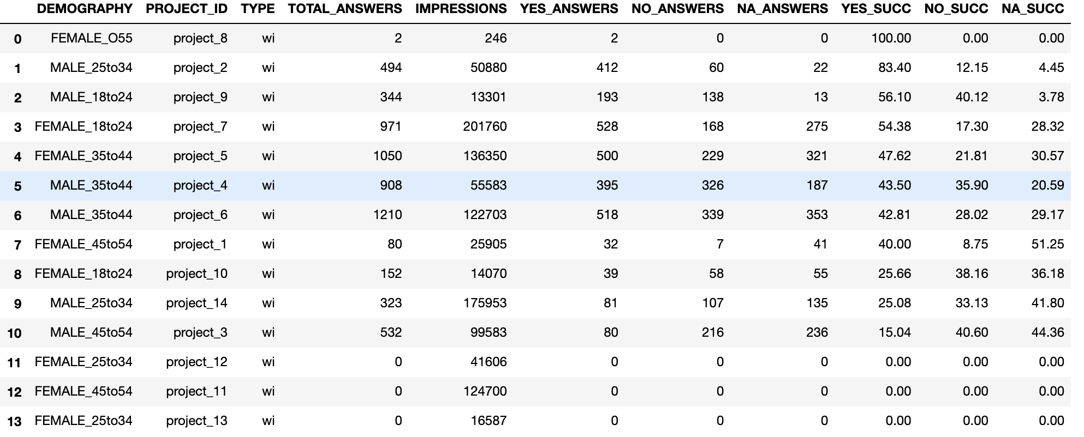
Data Exploration WI Surveys
What is the highest positive response percentage for different projects from different age groups across different countries?
Age group and gender for different projects with highest positive response percentage.

Slide 8
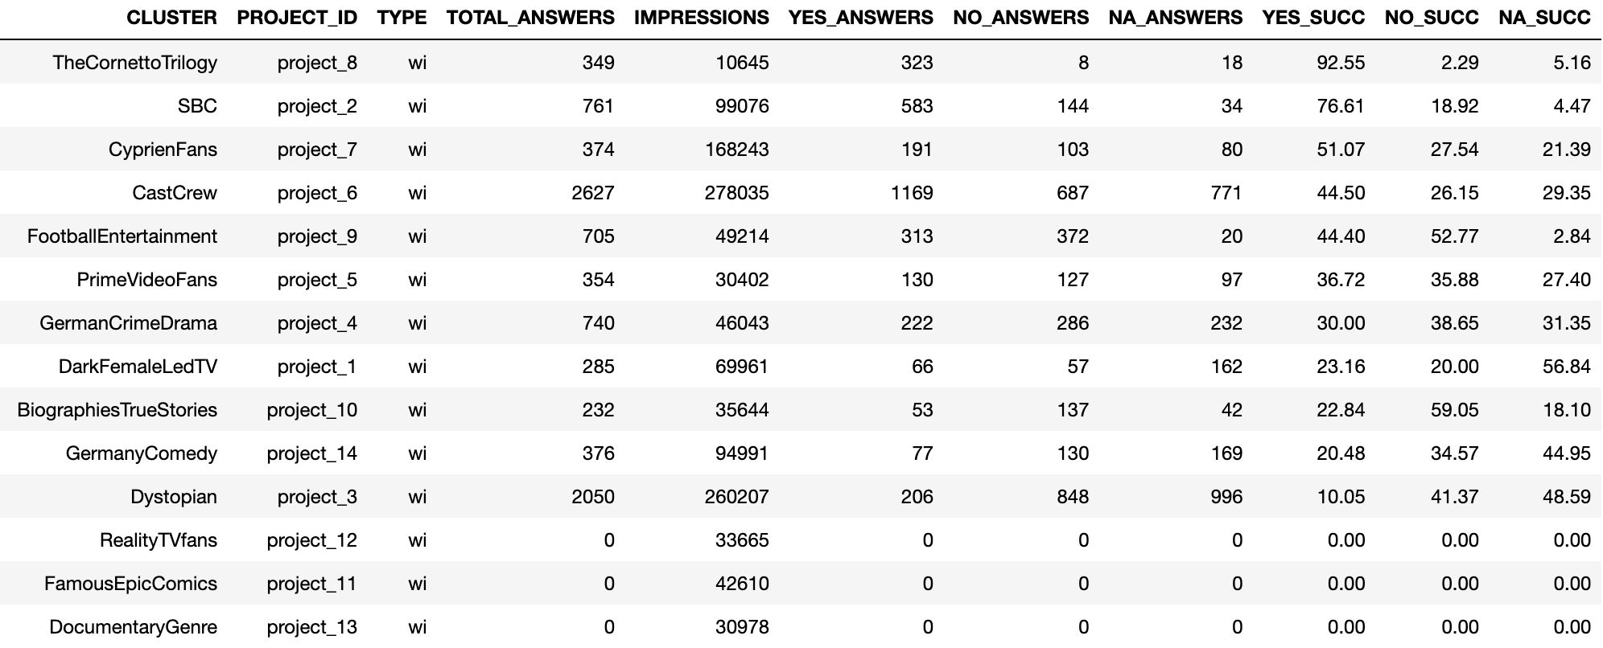
Data Exploration WI Surveys
What is the highest positive response percentage from different genre clusters for different projects across different countries?

Slide 9
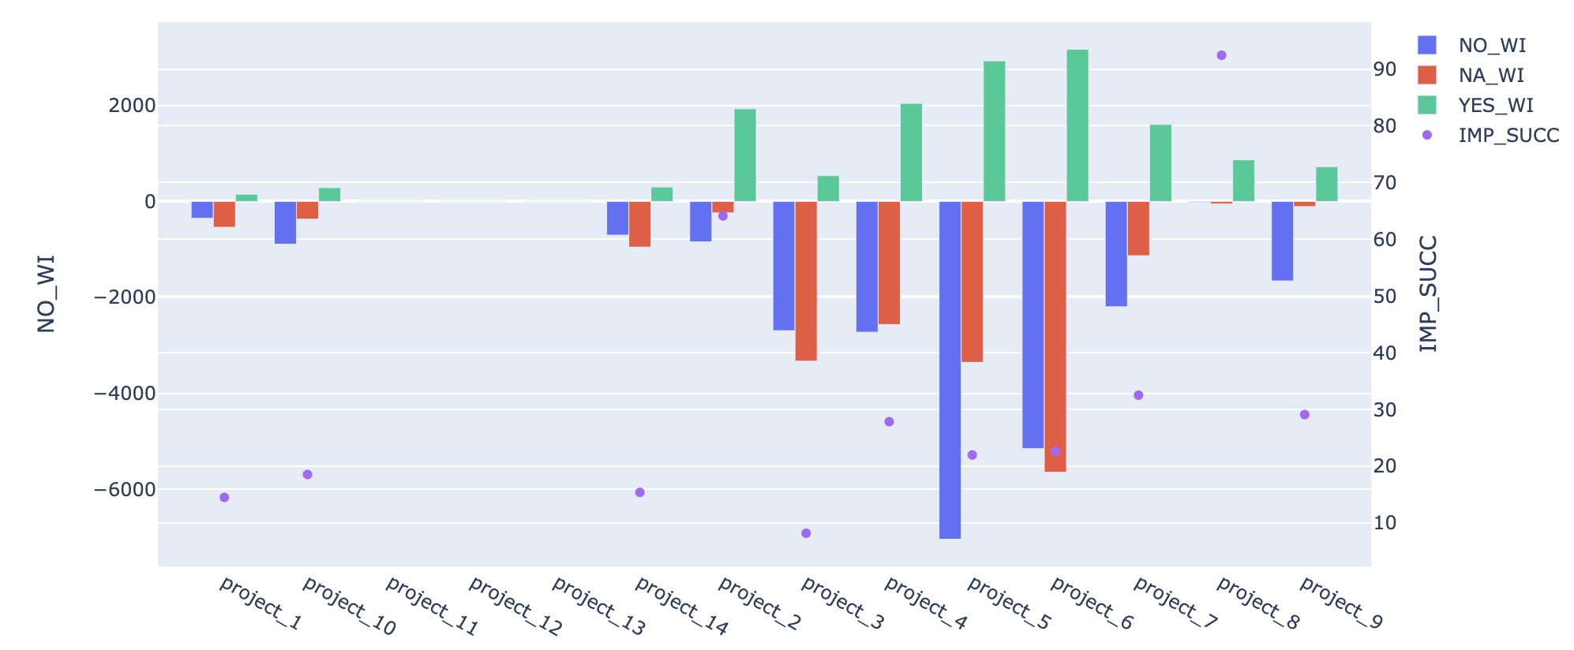
Data Exploration WI Surveys
What are the Yes, No and NA responses for projects and the respective positive response percentage?
Project intended to watch the most and the least

Slide 10
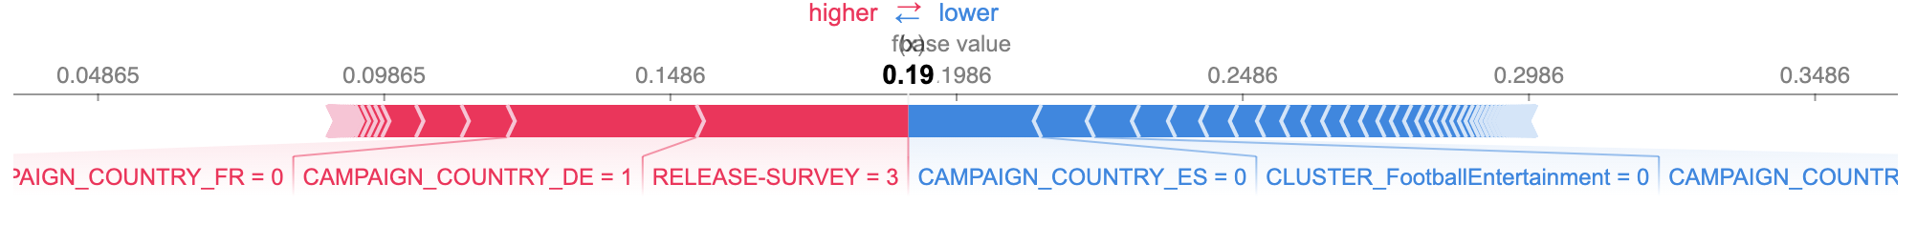
Feature Importance WI Surveys
Random Forest regressor used as the model to predict yes percentage
Features that push yes percentage prediction in positive or negetive side

Slide 11
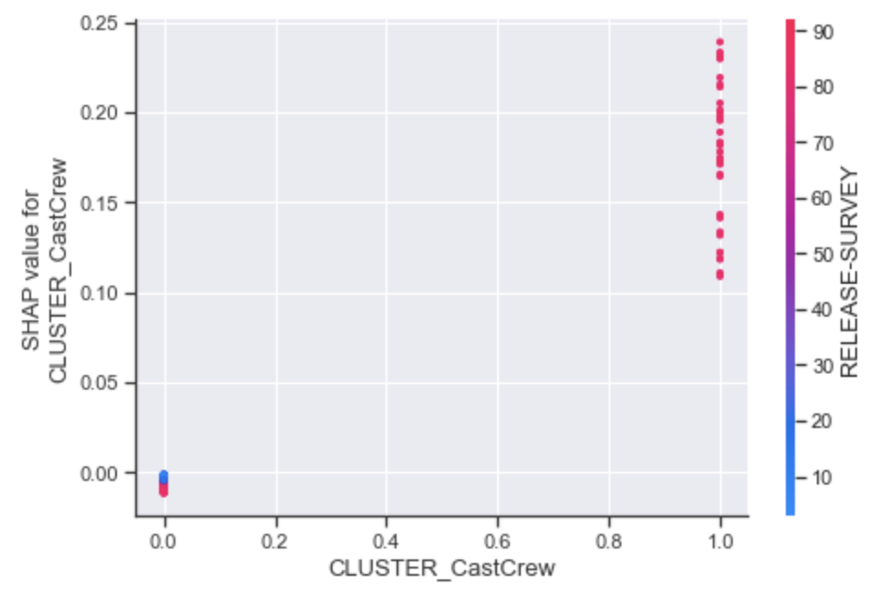
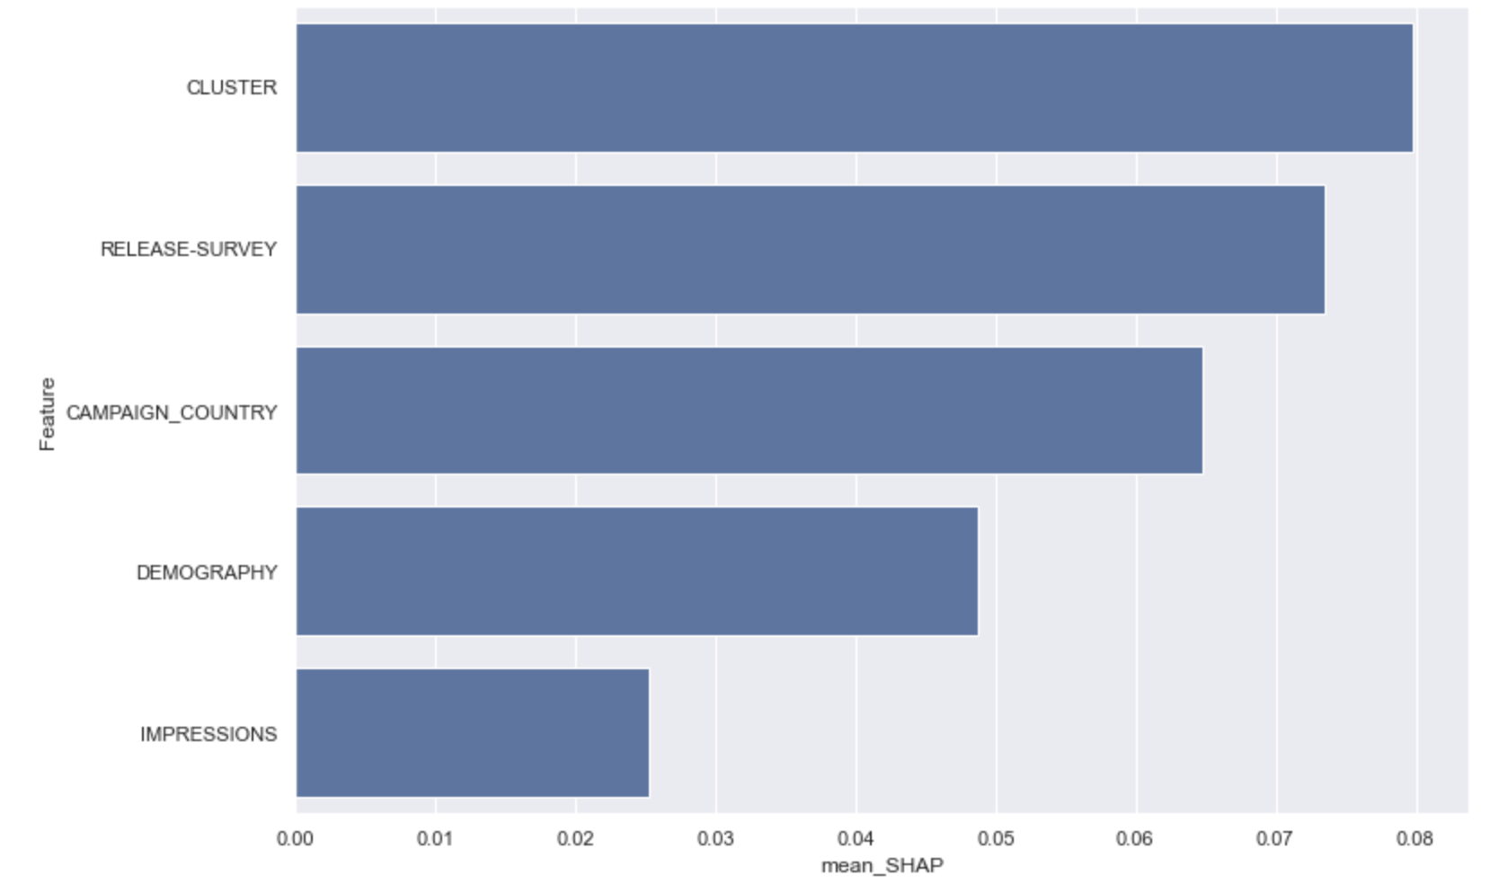
Feature Importance WI Surveys
Features influencing yes percentage predictions the most
Use of difference between release and survey date
Effect of feature values om yes percentage
prediction
Effect of Cast and Crew Cluster on release survey date difference

Slide 12
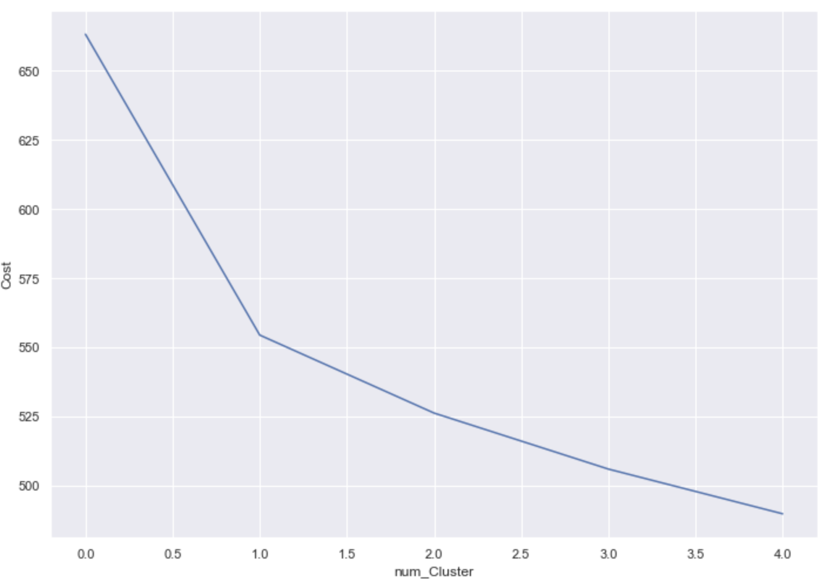
Cluster Analysis WI Surveys
Use of K Prototypes
Ease in use with mixed data types
Use of cluster means rather than modes
to reduce a cost functions
Use of matching disimmilarity instead of
eucledian distance metric
Finding optimal cluster numbers
Choosing 2 clusters as optimal, in cluster counts are:
Cluster0 : 959
Cluster1 : 665

Slide 13
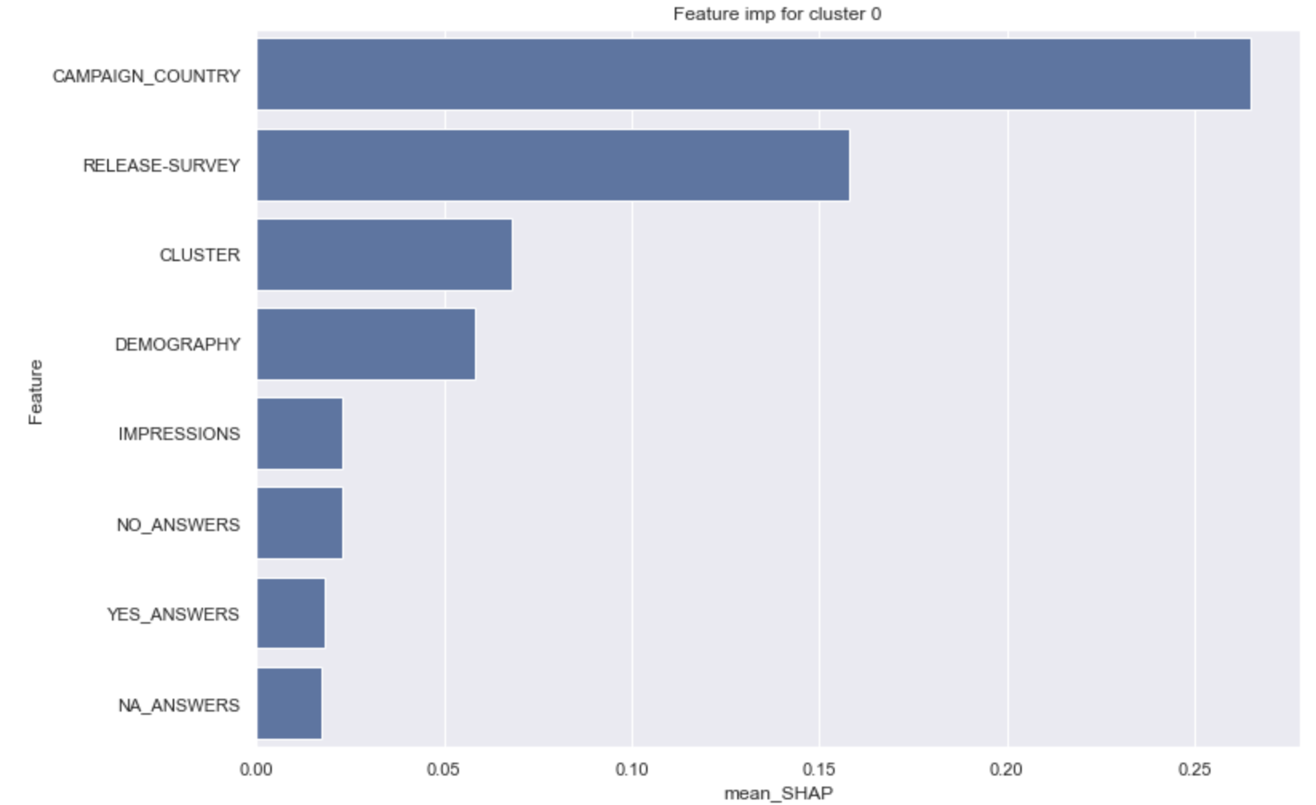
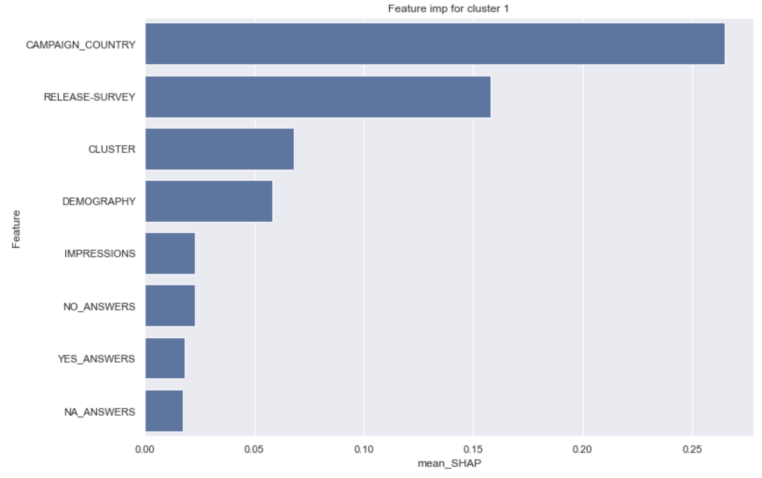
Cluster Analysis WI Surveys
Fitting a Random Forest Classifier for
cluster optimality check
Classifier accuracy = 98.15%
SHAP values calculated to check feature importance
Features importance for Cluster 0 and Cluster 1
Same features affecting both the clusters
Clusters formed mostly on Campaign countries and
release survey date difference
Impressions and responses has the least influence

Slide 14
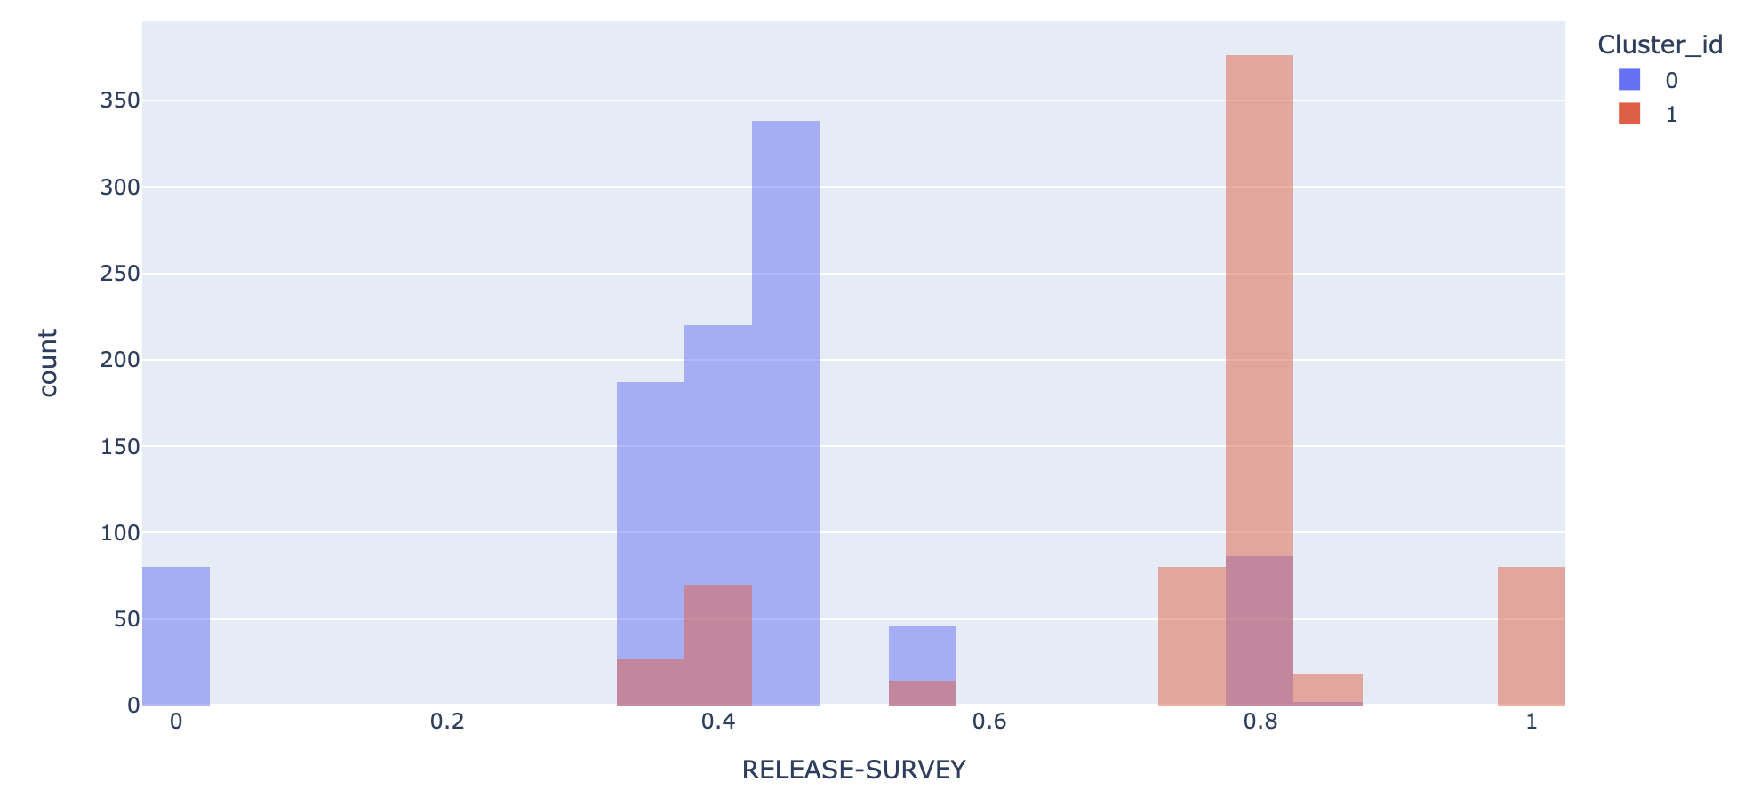
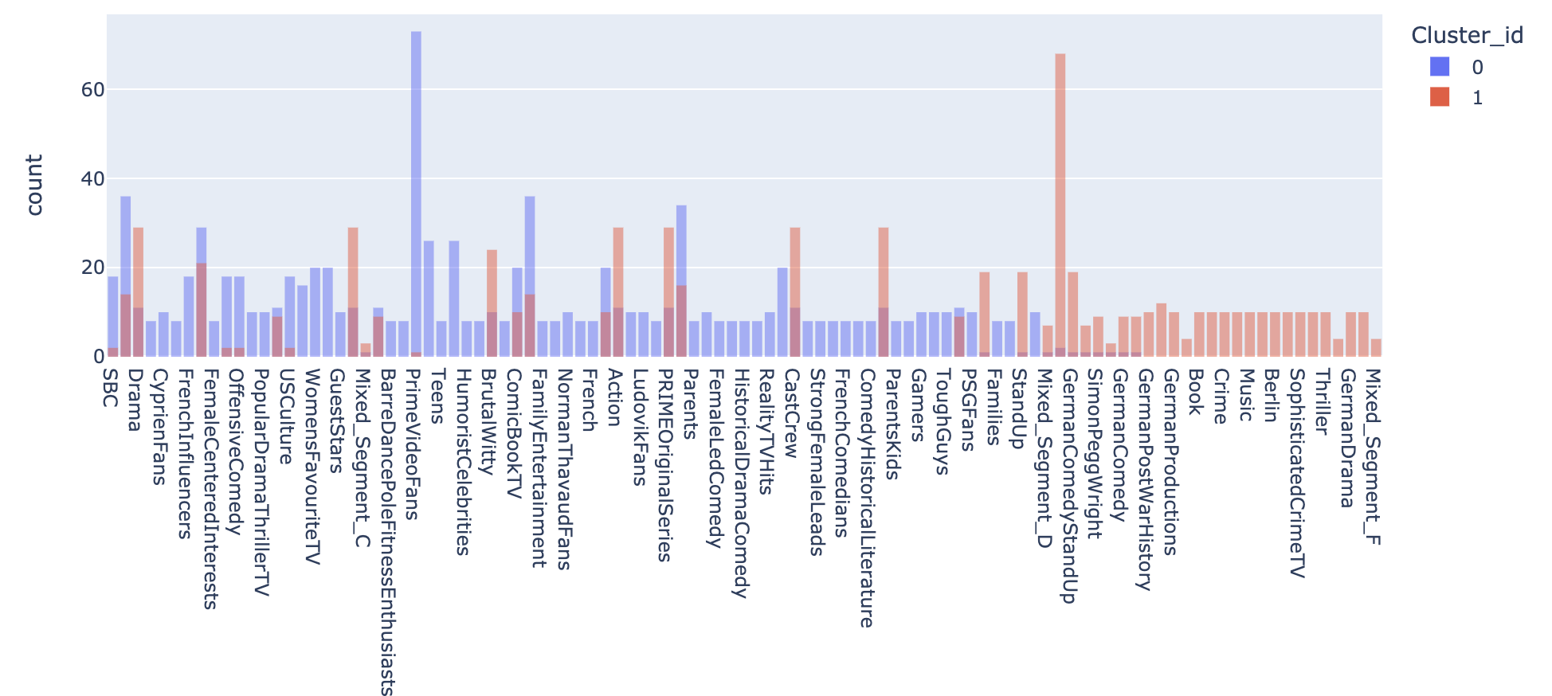
Cluster Analysis WI Surveys
Countplots for influential features

Slide 15
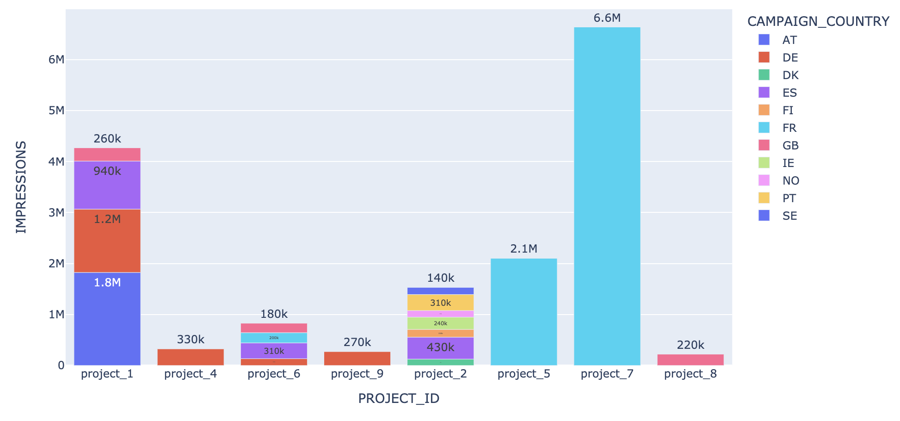
Data Exploration VC Surveys
What are the total impressions for all projects across different campaign countries?
Highest and least number of impressions
Projects surveyed in a single country
Projects surveyed widely in multiple
countries

Slide 16
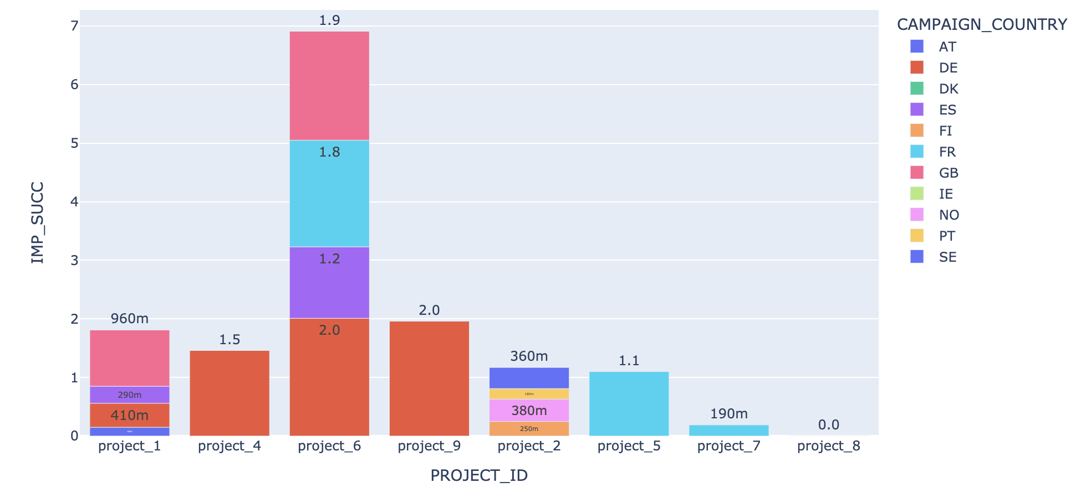
Data Exploration VC Surveys
What is the percentage of total reponses for different projects across all countries?
Highest and least total response percentages
Impressions for different project and
corresponding responses.
Relation between impression response
difference and survey targeting

Slide 17
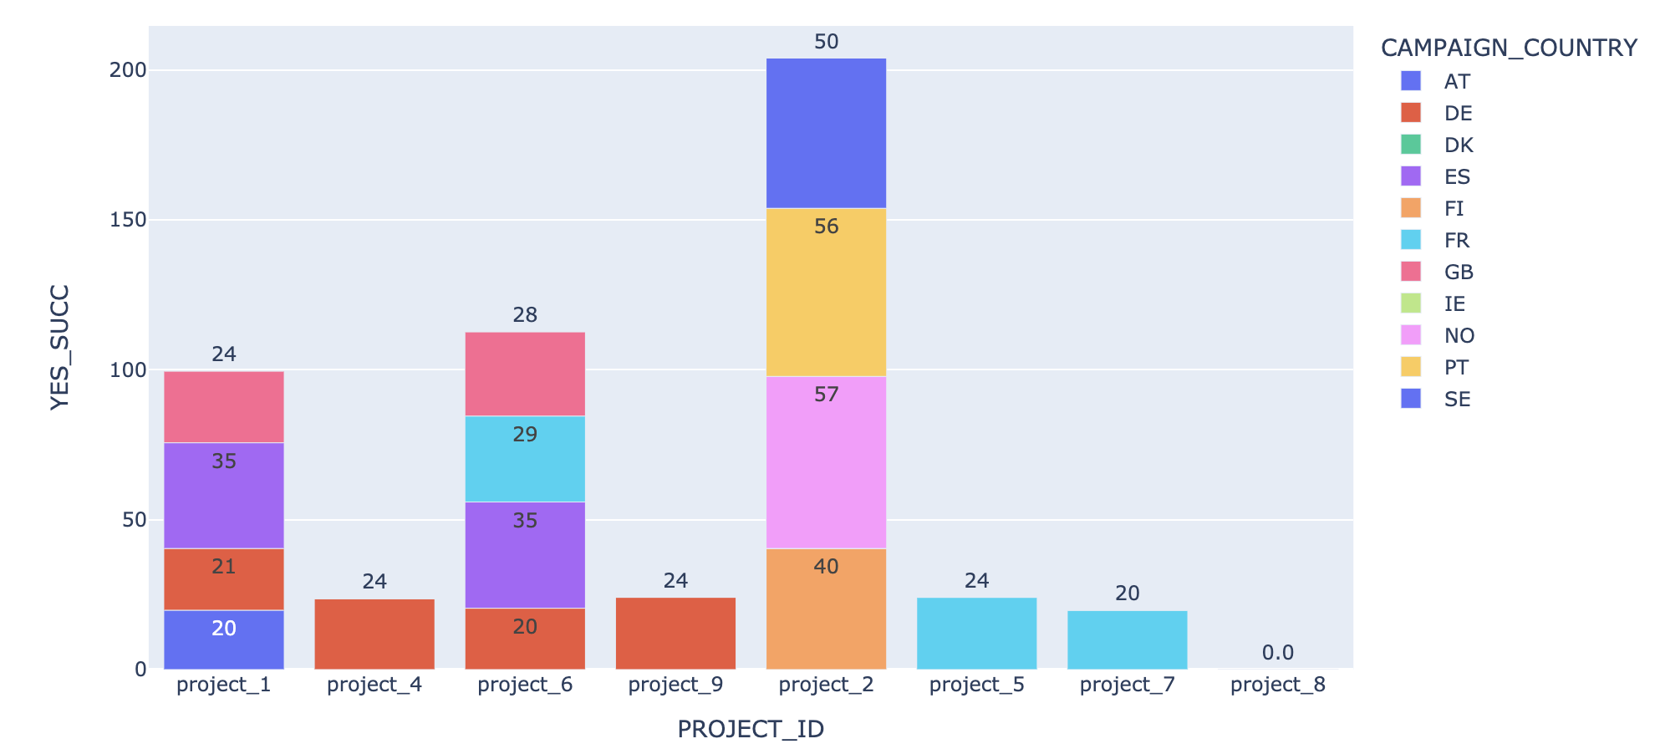
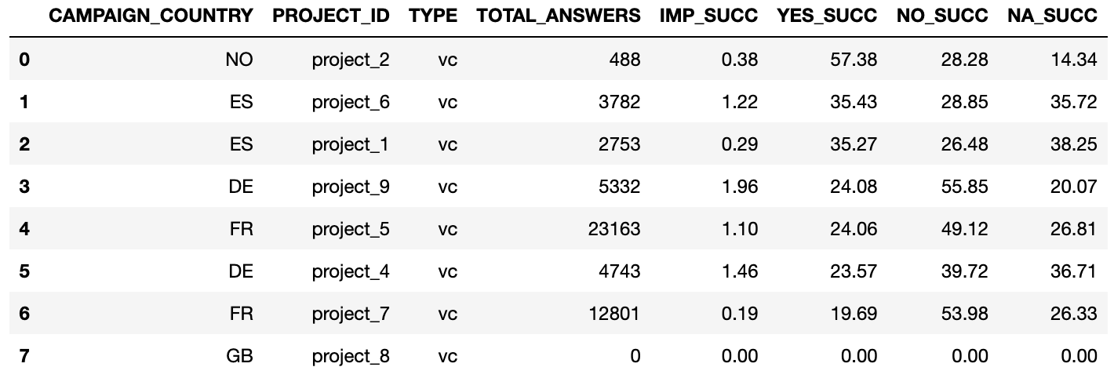
Data Exploration VC Surveys
What is the percentage of positive reponses for different projects across all countries?
Highest and least positive response percentages
Projects surveyed in multiple countries
Kind of responses recieved for projects

Slide 18
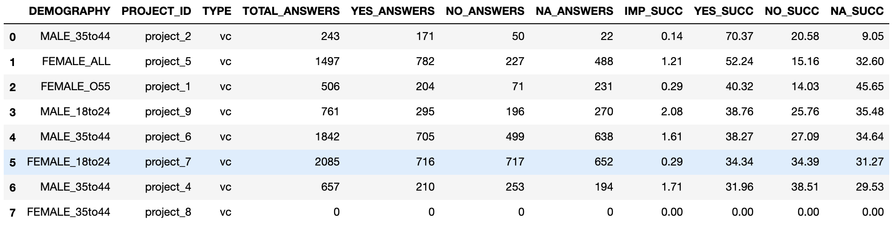
Data Exploration VC Surveys
What is the highest positive response percentage for different projects from different age groups across different countries?
Age group and gender for different projects with highest
positive response percentage.

Slide 19
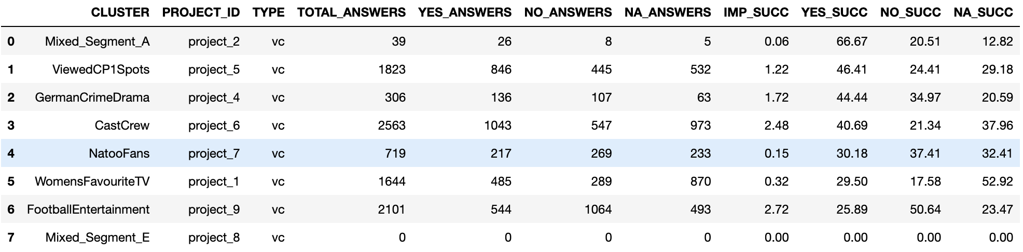
Data Exploration VC Surveys
What is the highest positive response percentage from different genre clusters for different projects across different countries?

Slide 20
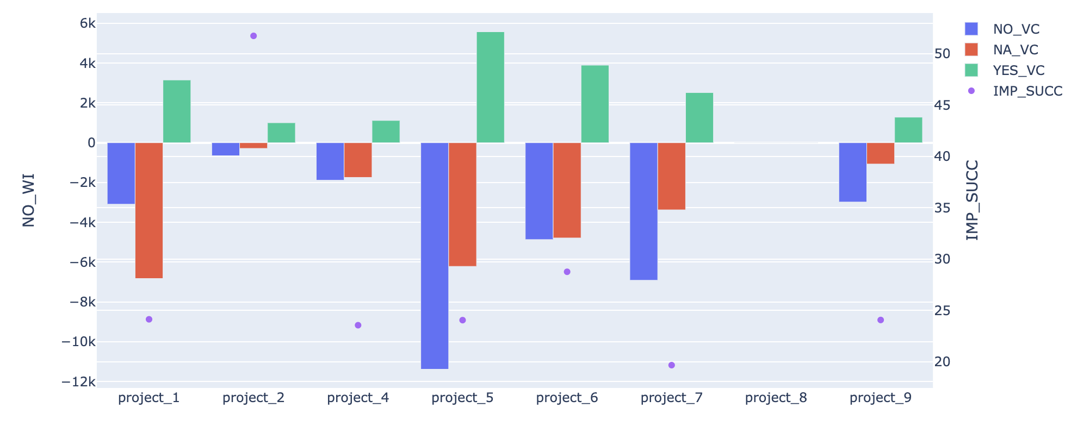
Data Exploration VC Surveys
What are the Yes, No and NA responses for projects and the respective positive response percentage?

Slide 21
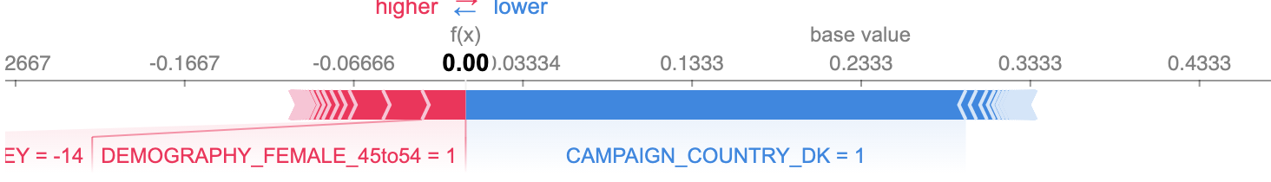
Feature Importance VC Surveys
Random Forest regressor used as the model to predict yes percentage
Features that push yes percentage prediction in positive or negetive side

Slide 22
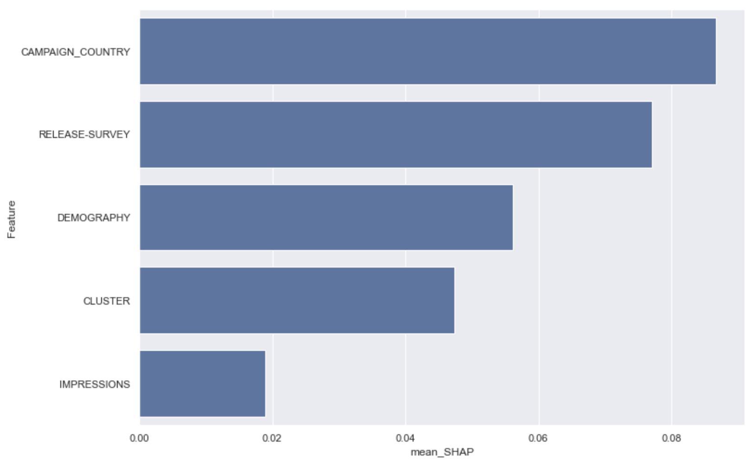
Feature Importance VC Surveys
Features influencing yes percentage predictions the most
Use of difference between release and survey date
Effect of feature values om yes percentage
prediction

Slide 23
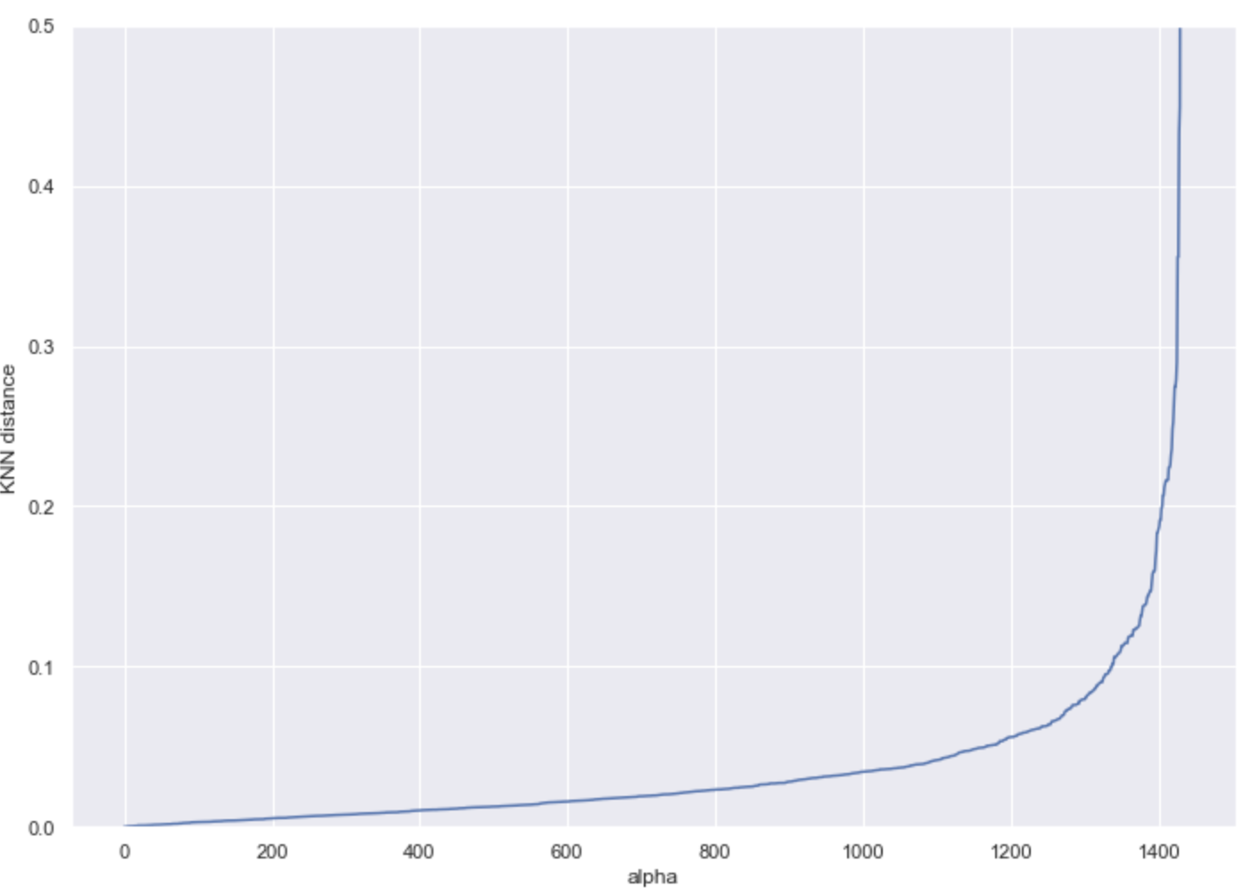
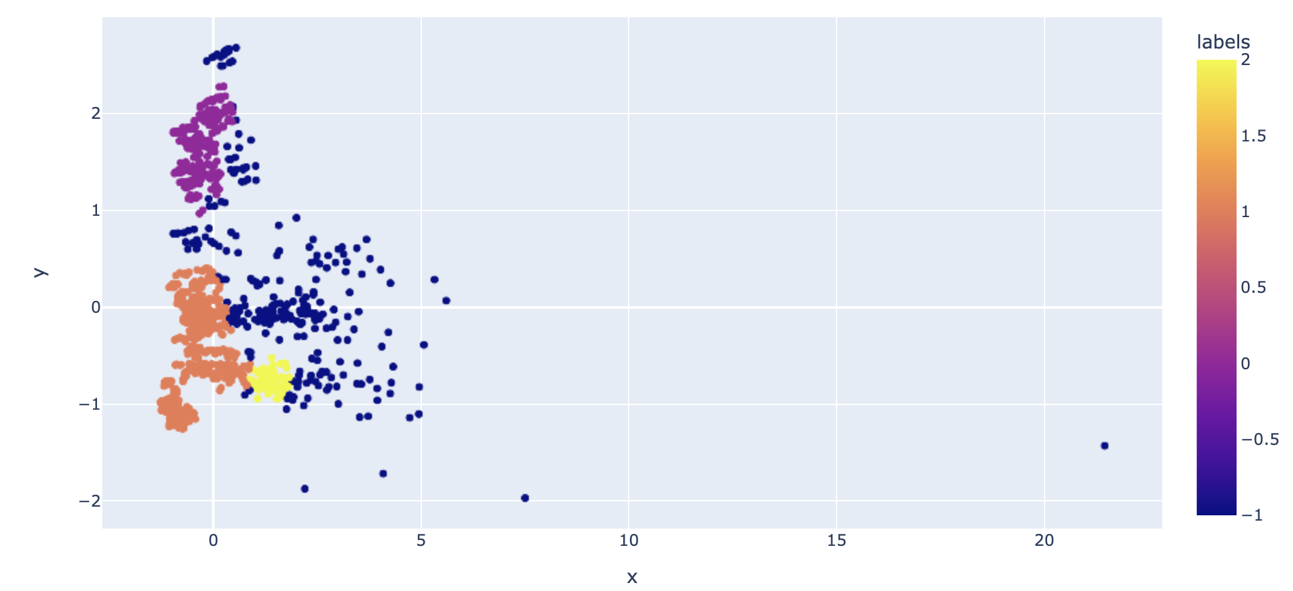
Cluster Analysis VC Surveys
Use of FAMD
Dimensionaltity reduction
Ease in plotting
Axes with highers variances are more likely to show clusters
Possible loss of informations as disadvantage
Use of DBSCAN
Able to identify non spehroidal clusters
Ability to handle outliers
Optimal clusters decided by the algorithm
Finding optimal DBSCAN parameters
3 clusters chosen as optimal, in cluster counts are:
Cluster0 : 276
Cluster1 : 820
Cluster2: 73
Cluster -1/3: 265

Slide 24
Cluster Analysis VC Surveys
Fitting a Random Forest Classifier for cluster optimality check
Classifier accuracy = 94.44%
SHAP values calculated to check feature importance
Features importance for Cluster 0 ,Cluster 1, Cluster 2 and Cluster 3/-1
Cluster 0 influenced by taste genre , impressions for survey and awareness of users
Clusters 1 & 2 influenced by release survey date difference
Impressions and responses has the least influence

Slide 25
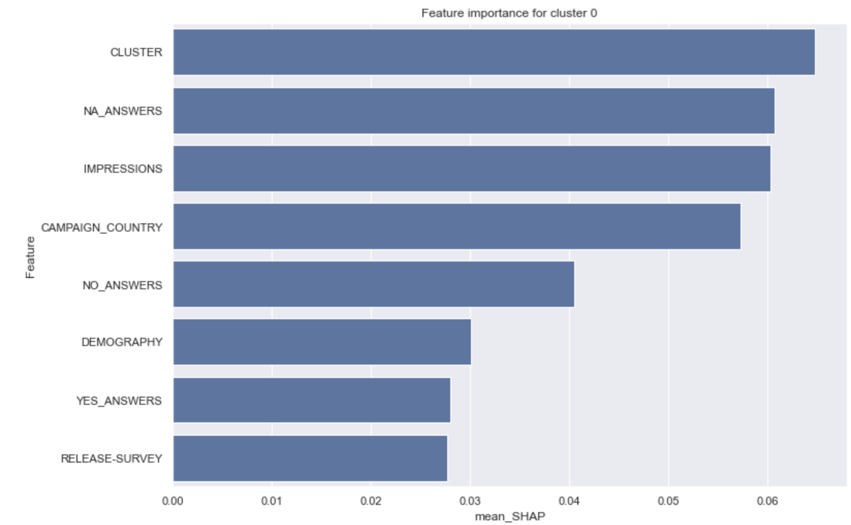
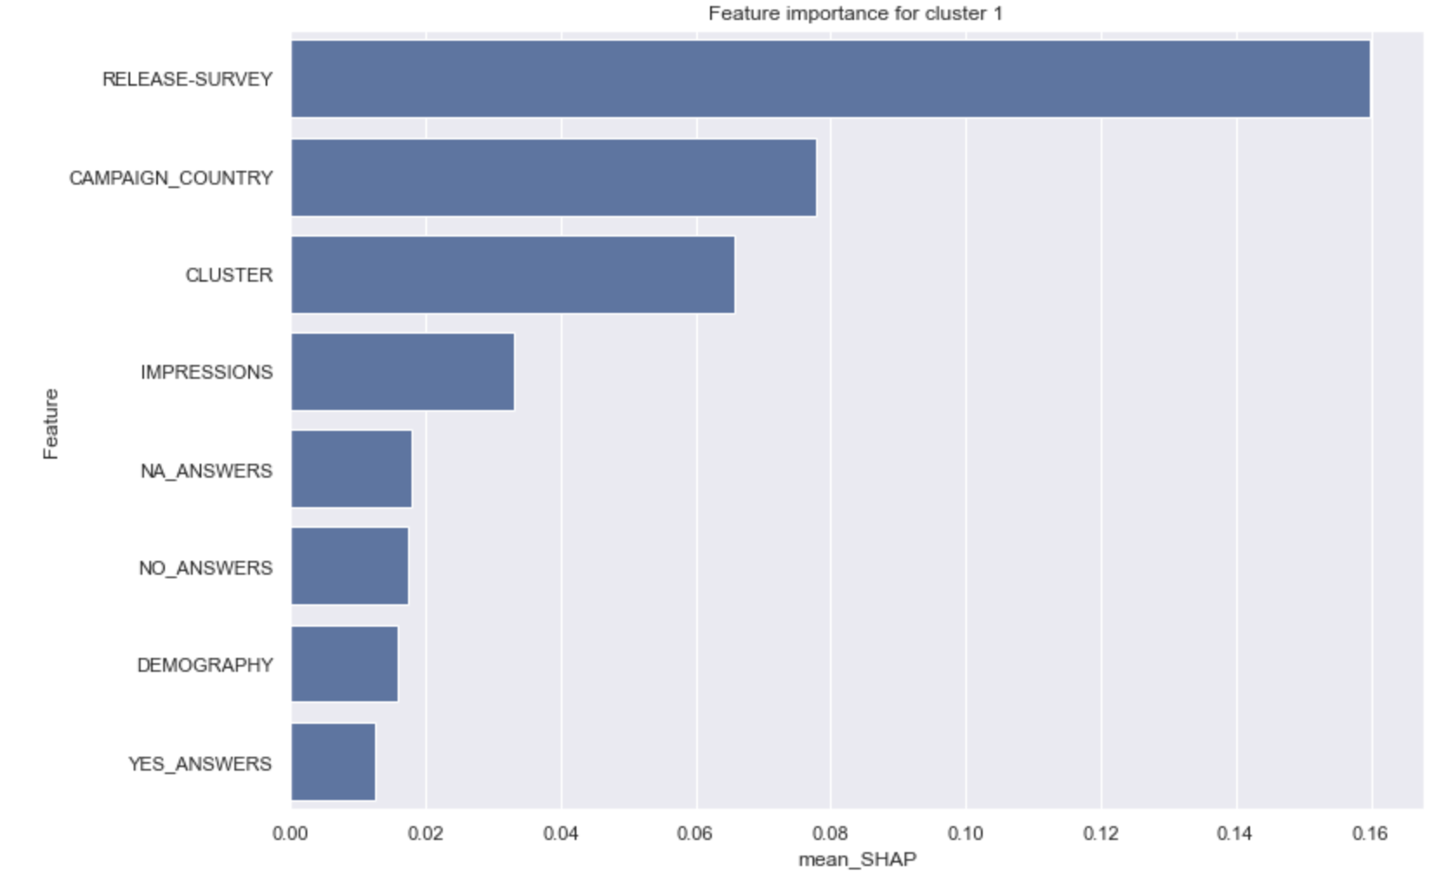
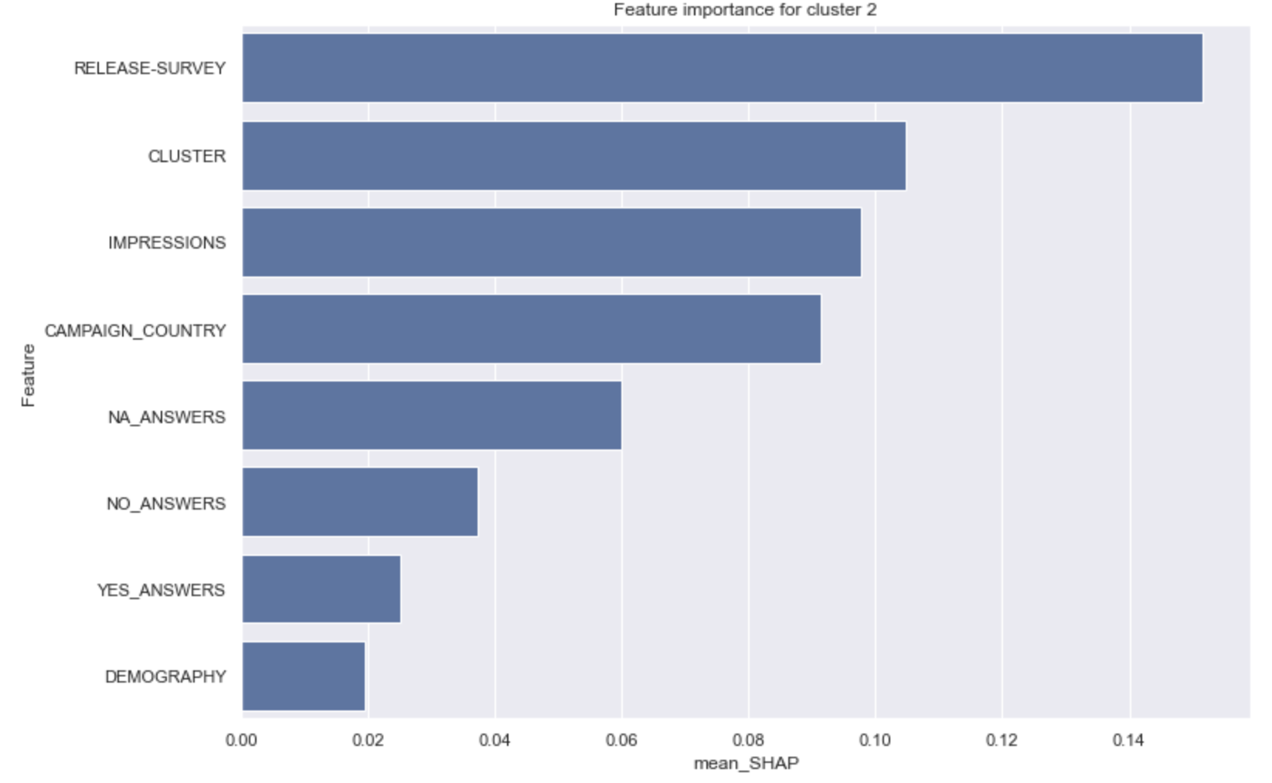
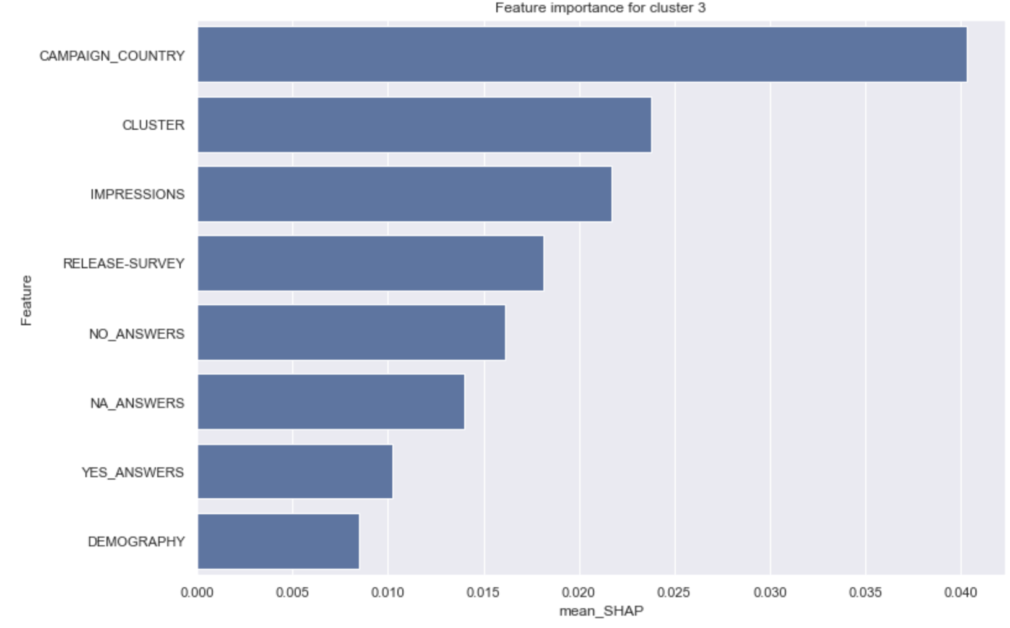
Cluster Analysis VC Surveys

Slide 26
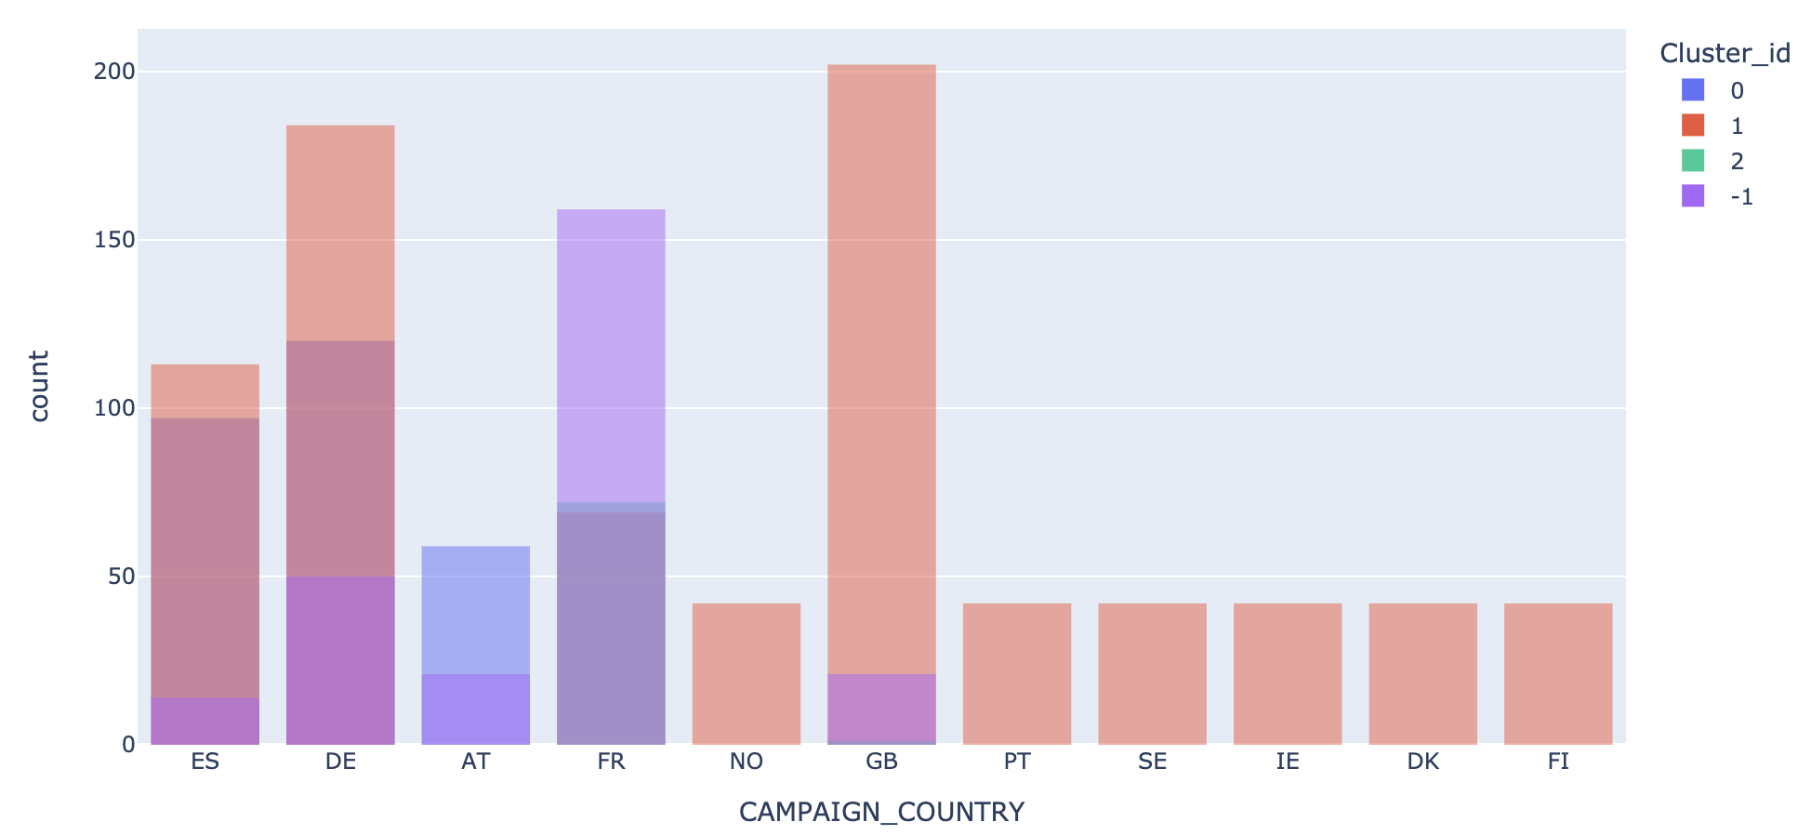
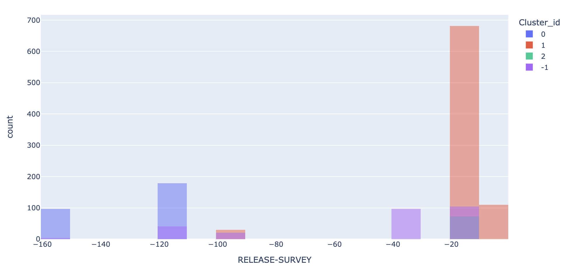
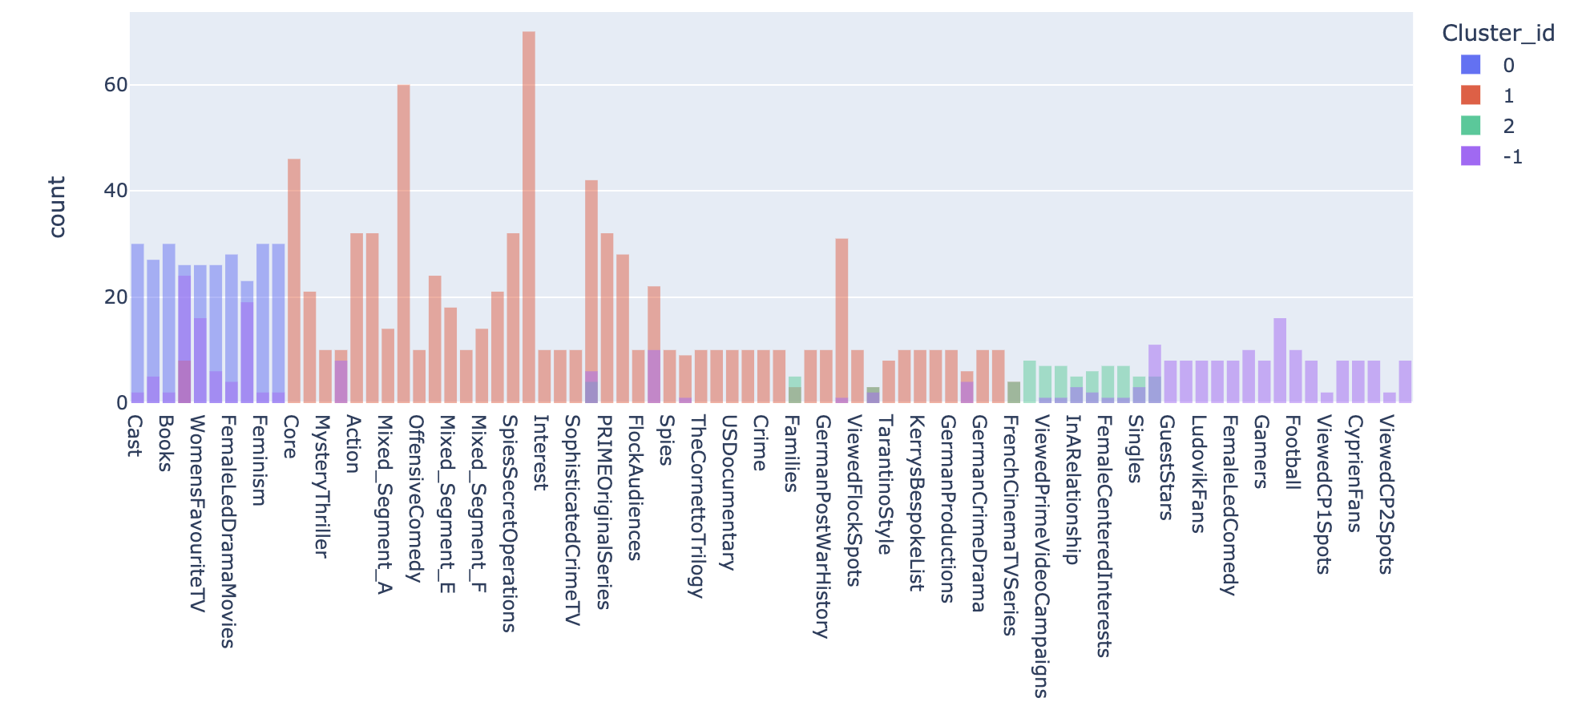
Cluster Analysis VC Surveys
Countplots for influential features

Slide 27
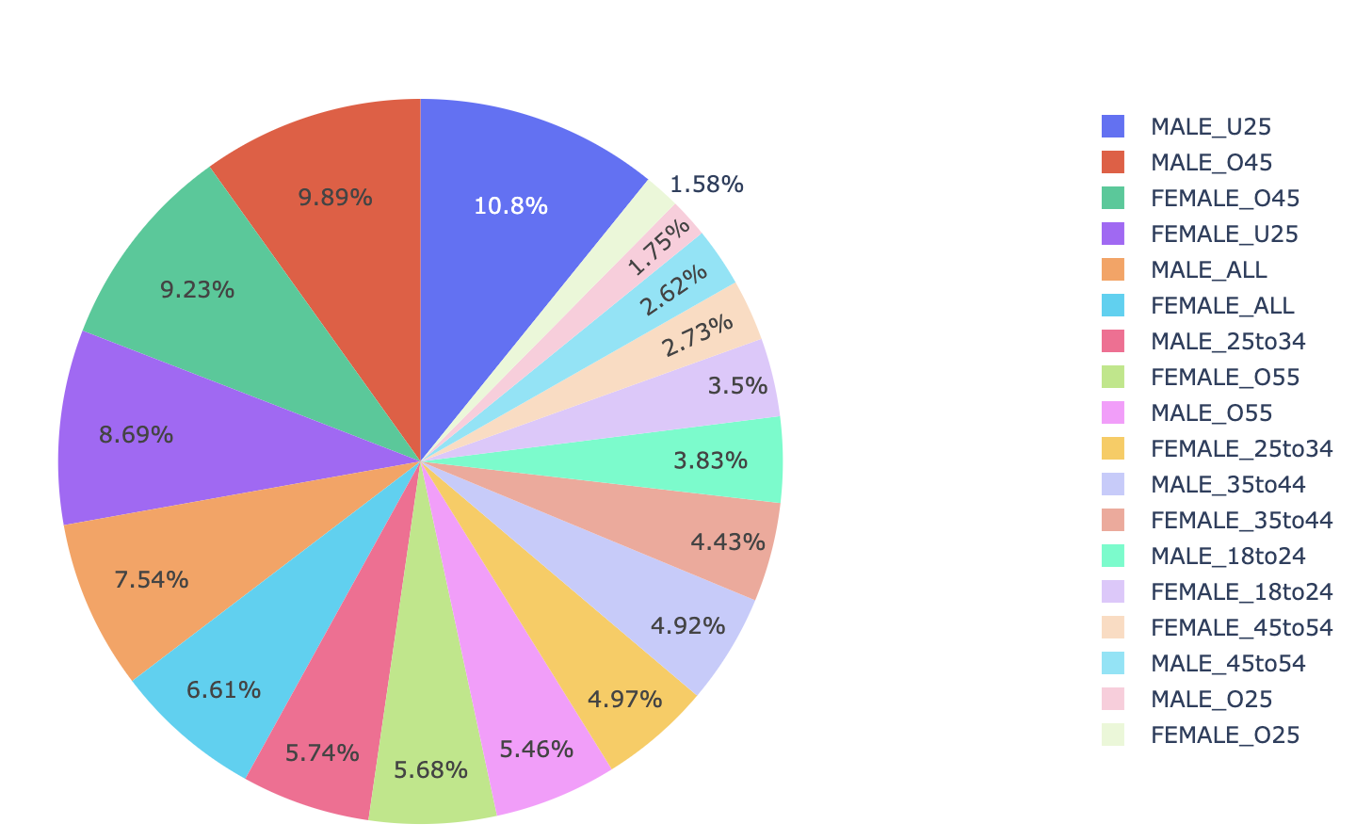
Data Exploration
Which age group is more responsive to surveys?
Highest and least responsive age groups

Slide 28
Data Exploration
Which taste genre is most likes across different countries?

Slide 29
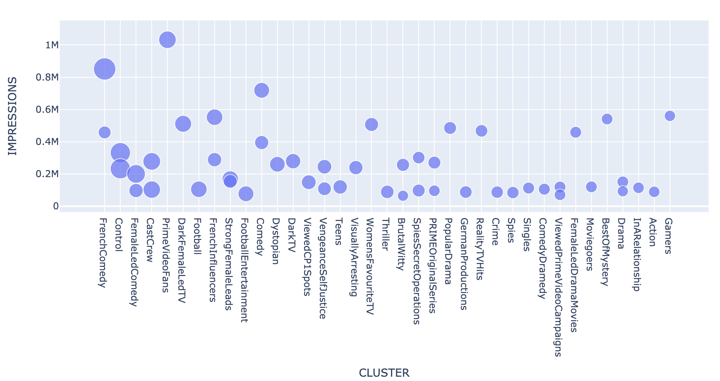
Data Exploration
What are top 50 taste clusters based on total repsonses against the impressions?
Cluster which gives highest and least responses for given number of impressions
Clusters with low impressions but high responses and vice versa

Slide 30
Possible prediction tasks
Prediction of Yes percentage for both surveys given the data
Predicting the genre of the projects
Predicting the age group that would watch the project or intend to watch it

Slide 31
Improvements/Changes in data collection
The DEMOGRAPHY feature can be collected in a more structure way where the bin ranges don’t overlap
The taste audience cluster can be more generic rather than being detailed. For eg. Prime Video Fans, Simon Pegg Wright are too specific and can be generalized further.
For VC surveys the IMDB/Rotten Tomatoes rating and number of reviews of the project could also be collected.
Type of project can also be included for both surveys, eg. Series, Movie, Documentary etc.
Runtime can also be a important feature. However the difference in the runtimes of different project types could cause a problem and need to brought to a common scale.
Original project language, number of OTT platforms it is available on (for VC) are some probable new features to be added.

Slide 32







Model deployement
Git Push
CI/CD
Provisioning AWS services through cloud formation/ infrastructure as code
Web Service
Data Preprocessing
Model Deployment, Training and Evaluation
or
Event Notification to users / stakeholders

